Slide 1

DEPARTMENT OF COMPUTER SCIENCE AND ENGINEERING
Speech Emotion Recognition using
Constant-Q Transform and RNN
Name of students:
SALMAN FARIS SYED: 210071601160
MOHAMMED ZAHAAN K : 210071601130
Supervisor:
Dr. S Revathi
Domain of project : MACHINE LEARNING
01

Slide 2
DEPARTMENT OF COMPUTER SCIENCE AND ENGINEERING
ABSTRACT
Recognizing emotions in speech is complex, with traditional methods often failing to capture nuanced expressions.
It uses CQT and RNNs to catch emotional patterns in how something is said, not just what’s said.
Users can record or upload voice clips and get instant results showing both text and detected emotion.
Useful in mental health, education, and customer support—this tech brings machines closer to understanding humans emotionally.
Speech Emotion Recognition using
Constant-Q Transform and RNN
02

Slide 3
DEPARTMENT OF COMPUTER SCIENCE AND ENGINEERING
PROBLEM STATEMENT
Accurately detecting emotions in speech signals is a challenging task within affective computing.
Current approaches often rely on traditional signal processing and handcrafted features, which may miss subtle emotional cues.
There is a demand for more sophisticated methods that can effectively capture the nuances of emotional expression in speech.
Inadequate emotion recognition hinders advancements in applications like human-computer interaction and mental health monitoring.
Speech Emotion Recognition using
Constant-Q Transform and RNN
03

Slide 4
DEPARTMENT OF COMPUTER SCIENCE AND ENGINEERING
RELATED WORK
Title | Author | Year | Limitations | Advantage
Speech Emotion Recognition Via CNN-Transformer and Multidimensional Attention Mechanism | Xiaoyu Tang, Yixin Lin, Ting Dang, Yuanfang Zhang, Jintao Cheng | 2024 | High computational cost and needs large datasets to perform well. | Combines CNN and Transformer with attention, improving emotion detection and temporal modeling
Speech Emotion Recognition Using Attention Model | Jagjeet Singh, Lakshmi Saheer, Oliver Faust | 2023 | Limited handling of long-term emotional changes and may struggle with generalization. | Attention model highlights emotional features with a simpler architecture.
04

Slide 5
DEPARTMENT OF COMPUTER SCIENCE AND ENGINEERING
Title | Author | Year | Limitations | Advantage
Multi-Scale Temporal Transformer For Speech Emotion Recognition | Zhipeng Li, Xiaofen Xing, Yuanbo Fang, Weibin Zhang, Hengsheng Fan, Xiangmin Xu | 2024 | Computationally heavy and prone to overfitting on small or similar data. | Multi-scale temporal structure captures short- and long-term emotional cues effectively.
Emotion Neural Transducer for Fine-Grained Speech Emotion Recognition | Siyuan Shen, Yu Gao, Feng Liu, Hanyang Wang, Aimin Zhou | 2024 | Sensitive to noise and requires detailed annotations. | Frame-level emotion detection enables fine-grained emotional tracking.
Integrating Emotion Recognition with Speech Recognition and Speaker Diarisation for Conversations | Wen Wu, Chao Zhang, Philip C. Woodland | 2023 | System complexity is high and depends on accurate speech/speaker modules. | Integrates emotion, speech, and speaker recognition for conversation analysis.
05

Slide 6
DEPARTMENT OF COMPUTER SCIENCE AND ENGINEERING
Title | Author | Year | Limitations | Advantage
Lightweight Neural Networks for Speech Emotion Recognition using Layer-wise Adaptive Quantization | Tushar Shinde, Ritika Jain, Avinash Kumar Sharma | 2024 | Slight drop in accuracy and limited emotional expression handling. | Lightweight model with adaptive quantization suits low-power devices.
An Empirical Study and Improvement for Speech Emotion Recognition | Zhen Wu, Yizhe Lu, Xinyu Da | 2023 | Lacks novelty and contributions are mostly incremental. | Offers practical improvements and strong benchmarking of SER models.
Double Multi-Head Attention Multimodal System for Odyssey 2024 Speech Emotion Recognition Challenge | Federico Costa, Miquel India, Javier Hernando | 2024 | Complex and resource-heavy, less suited for real-time use. | Multi-head attention with multimodal inputs boosts accuracy.
06

Slide 7
DEPARTMENT OF COMPUTER SCIENCE AND ENGINEERING
Title | Author | Year | Limitations | Advantage
Speech Emotion Recognition with Distilled Prosodic and Linguistic Affect Representations | Debaditya Shome, Ali Etemad | 2023 | Performance depends on accurate feature extraction. | Combines prosodic and linguistic cues for better emotion detection.
Enhancing Speech Emotion Recognition Through Differentiable Architecture Search | Thejan Rajapakshe, Rajib Rana, Sara Khalifa, Berrak Sisman, Björn Schuller | 2023 | High computational cost and limited interpretability. | Auto-designed models via architecture search yield strong results.
07

Slide 8
DEPARTMENT OF COMPUTER SCIENCE AND ENGINEERING
PROPOSED WORK
Objective
To enhance speech emotion recognition accuracy by integrating Constant-Q Transform with RNN.
The system uses audio signals processed into spectrograms through Constant-Q Transform for effective feature extraction.
The output consists of classified emotional states, providing insights into the speaker's feelings based on the analysed speech data.
The approach employs a combination of deep learning techniques, specifically CQT,RNN for emotion classification.
This method can be applied in various fields, including human-computer interaction, virtual assistants, and mental health monitoring.
Input
Output
Algorithm Used
Scope
Speech Emotion Recognition using
Constant-Q Transform and RNN
08

Slide 9
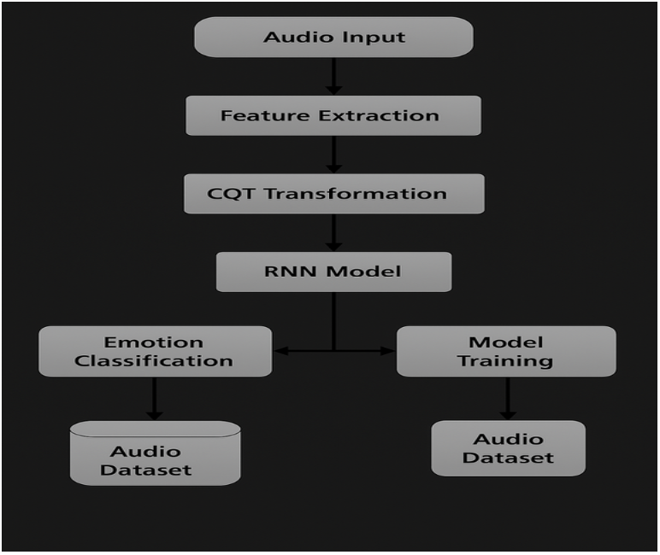
DEPARTMENT OF COMPUTER SCIENCE AND ENGINEERING
METHODOLOGY
Speech Emotion Recognition using
Constant-Q Transform and RNN
09

Slide 10
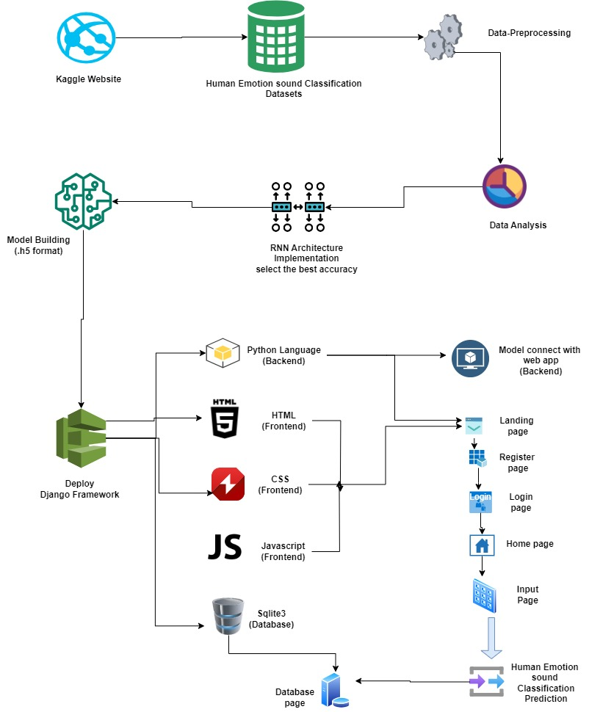
DEPARTMENT OF COMPUTER SCIENCE AND ENGINEERING
ARCHITECTURE
Speech Emotion Recognition using
Constant-Q Transform and RNN
10

Slide 11
DEPARTMENT OF COMPUTER SCIENCE AND ENGINEERING
METHODOLOGY
1. Data Collection
The first step involves gathering a labeled speech emotion dataset. Popular datasets such as RAVDESS, TESS, or CREMA-D were used. These datasets consist of audio samples spoken by actors, with each clip labeled with an emotion such as happy, sad, angry, neutral, and more.
2. Data Preprocessing
Raw audio files are often noisy or inconsistent in length, so preprocessing is crucial:
Resampling the audio to a consistent sampling rate (e.g., 44.1 kHz).
Trimming silence at the beginning and end.
Normalization of audio signals for uniform amplitude.
Conversion to mono channel if stereo.
3. Feature Extraction using CQT
Instead of feeding raw audio into the model, we extract meaningful patterns:
The Constant-Q Transform (CQT) is used to generate time-frequency spectrograms from audio.
CQT offers a logarithmic frequency scale, making it more aligned with how humans perceive sound.
These spectrograms are visual representations of frequency content over time and are used as inputs to the model.
Speech Emotion Recognition using
Constant-Q Transform and RNN
11

Slide 12
DEPARTMENT OF COMPUTER SCIENCE AND ENGINEERING
METHODOLOGY
4. Model Architecture: LSTM Network
Since speech is sequential in nature, a Recurrent Neural Network (RNN), particularly a Long Short-Term Memory (LSTM) model, is employed.
The model receives spectrograms as input and learns temporal dependencies and emotional patterns.
LSTM helps in maintaining context across time frames, which is crucial for emotion recognition.
The network ends with a softmax layer to classify the emotion from a set of predefined labels.
5. Model Training
The extracted features and labels are split into training, validation, and testing sets.
The model is trained using categorical cross-entropy as the loss function and Adam as the optimizer.
Multiple epochs are run to ensure the model generalizes well without overfitting.
Metrics such as accuracy and loss are monitored to fine-tune performance.
6. Evaluation and Testing
Once trained, the model is tested on unseen data.
A confusion matrix, accuracy score, and precision-recall metrics are used to evaluate how well the model identifies each emotion.
The model is also tested in real-time conditions to simulate live user inputs and evaluate responsiveness.
Speech Emotion Recognition using
Constant-Q Transform and RNN
12

Slide 13
DEPARTMENT OF COMPUTER SCIENCE AND ENGINEERING
METHODOLOGY
7. Integration with Django Interface
To make the model accessible and user-friendly:
A Django web interface was developed where users can upload or record speech.
The backend converts the audio into spectrogram, feeds it into the model, and returns the predicted emotion.
Results are displayed in a visual and interactive format for better understanding.
8. Execution in Jupyter via Anaconda
All development and experimentation were carried out in Jupyter Notebook through Anaconda Navigator.
This environment offers an organized way to test, visualize, and debug every part of the project in real-time.
Speech Emotion Recognition using
Constant-Q Transform and RNN
13

Slide 14


DEPARTMENT OF COMPUTER SCIENCE AND ENGINEERING
FRONT END:
Figure 1 : Welcome page
Figure 2 : Registration page
Speech Emotion Recognition using
Constant-Q Transform and RNN
14

Slide 15


DEPARTMENT OF COMPUTER SCIENCE AND ENGINEERING
FRONT END:
Figure 3 : Login page
Figure 4 : Home page
Speech Emotion Recognition using
Constant-Q Transform and RNN
15

Slide 16
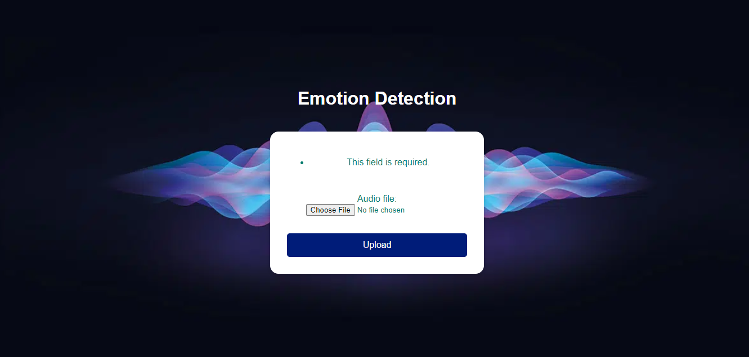

DEPARTMENT OF COMPUTER SCIENCE AND ENGINEERING
FRONT END:
Figure 5 : File selection page
Figure 6 : Emotion detection page
Speech Emotion Recognition using
Constant-Q Transform and RNN
16

Slide 17
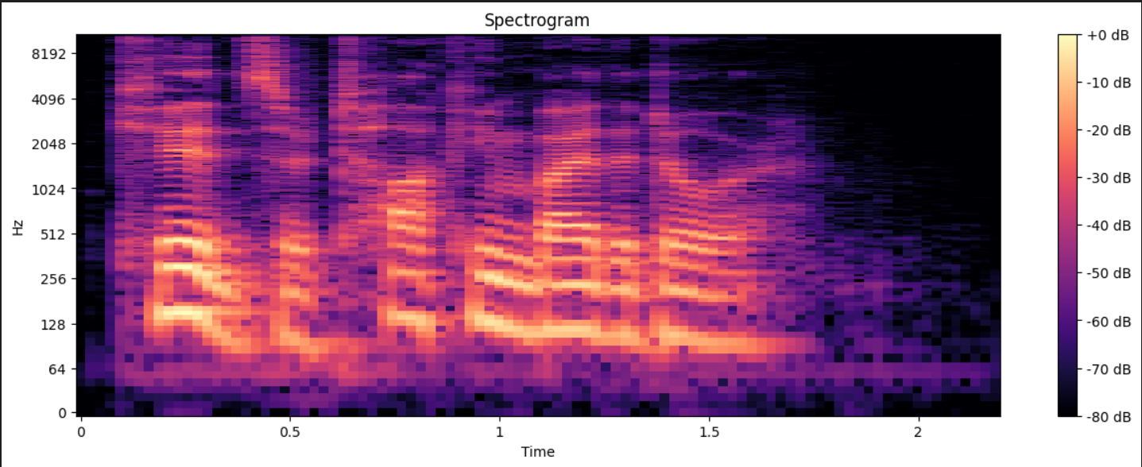
DEPARTMENT OF COMPUTER SCIENCE AND ENGINEERING
BACK END:
Figure 7 : Spectrogram
Speech Emotion Recognition using
Constant-Q Transform and RNN
17

Slide 18
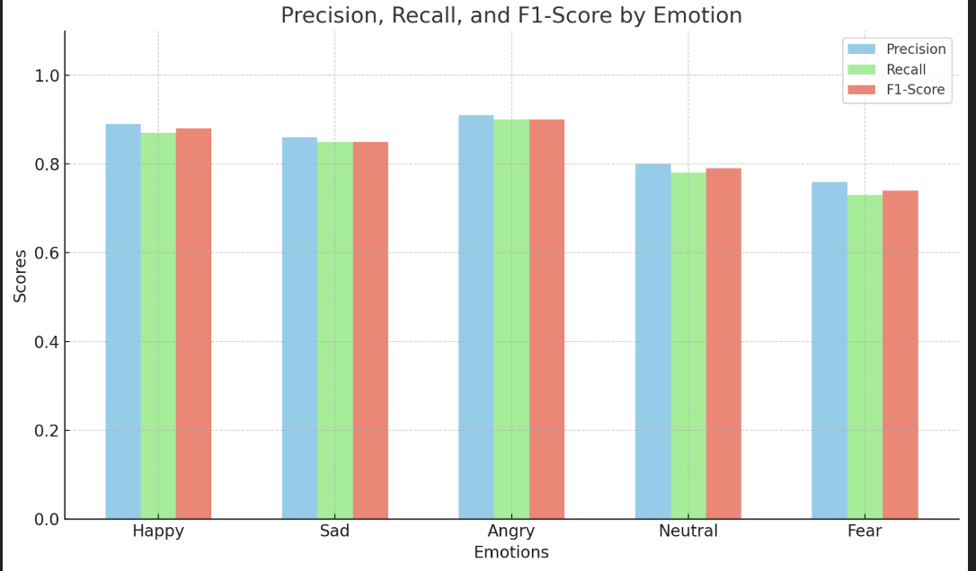
DEPARTMENT OF COMPUTER SCIENCE AND ENGINEERING
RESULTS:
Emotion | Precision | Recall | F1-Score
Happy | 0.89 | 0.87 | 0.88
Sad | 0.86 | 0.85 | 0.85
Angry | 0.91 | 0.90 | 0.90
Neutral | 0.80 | 0.78 | 0.79
Fear | 0.76 | 0.73 | 0.74
Table 1 : Classification Report
Figure 8 : Classification Report graph
Speech Emotion Recognition using
Constant-Q Transform and RNN
X-axis represents emotions
Y-axis represents scores
18

Slide 19
DEPARTMENT OF COMPUTER SCIENCE AND ENGINEERING
RESULTS:
The performance metrics table provides a clear insight into the model's effectiveness in recognizing various emotions from speech. The model performs well in detecting high-arousal emotions such as angry and happy, with high F1-scores indicating both strong precision and recall. Emotions like sad also show consistent results with a balanced performance. However, the accuracy decreases slightly for more subtle or overlapping emotions like neutral and fear, which have relatively lower F1-scores. These results suggest that while the model is effective for expressive emotional states, there is room for improvement in identifying low-intensity or ambiguous emotions.
Speech Emotion Recognition using
Constant-Q Transform and RNN
19

Slide 20
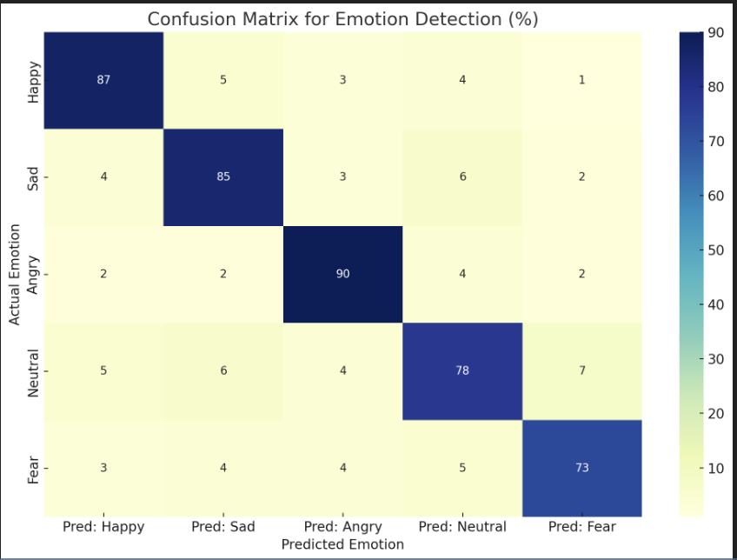
DEPARTMENT OF COMPUTER SCIENCE AND ENGINEERING
RESULTS:
 | Pred: Happy | Pred: Sad | Pred: Angry | Pred: Neutral | Pred: Fear
Actual: Happy | 87% | 5% | 3% | 4% | 1%
Actual: Sad | 4% | 85% | 3% | 6% | 2%
Actual: Angry | 2% | 2% | 90% | 4% | 2%
Actual: Neutral | 5% | 6% | 4% | 78% | 7%
Actual: Fear | 3% | 4% | 4% | 5% | 73%
Table 2 : Confusion Matrix
Figure 9 : Confusion Matrix graph
Speech Emotion Recognition using
Constant-Q Transform and RNN
20

Slide 21
DEPARTMENT OF COMPUTER SCIENCE AND ENGINEERING
RESULTS:
The confusion matrix highlights the classification performance of the emotion detection model across five emotions. The model shows high accuracy in identifying distinct emotions like happy, sad, and angry, with correct prediction rates of 87%, 85%, and 90% respectively. However, it demonstrates more confusion in recognizing neutral and fear, with only 78% and 73% accuracy. Misclassifications often occur between neutral and other emotions such as sad and fear, indicating some overlap in acoustic features. Despite these occasional errors, the model overall performs well, particularly for strongly expressed emotions
Speech Emotion Recognition using
Constant-Q Transform and RNN
21

Slide 22
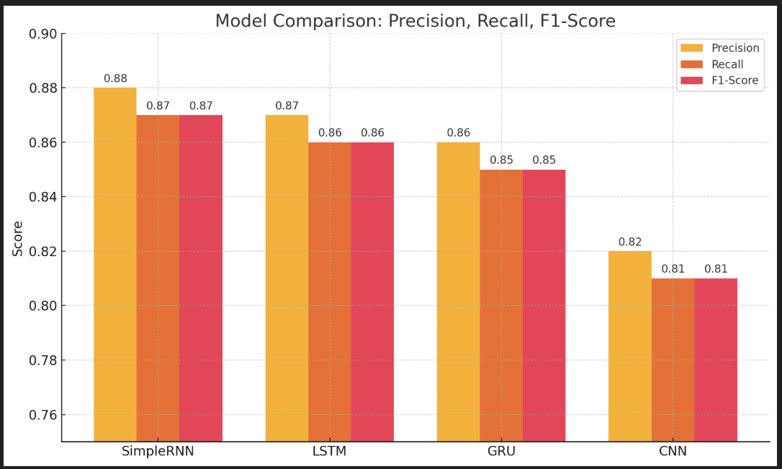
DEPARTMENT OF COMPUTER SCIENCE AND ENGINEERING
COMPARISON MODEL:
Model | Precision | Recall | F1-Score
Simple RNN | 0.88 | 0.87 | 0.87
LSTM | 0.87 | 0.86 | 0.86
GRU | 0.86 | 0.85 | 0.85
CNN | 0.82 | 0.81 | 0.81
Table 3 : Comparison Model
Figure 10 : Classification Report Graph
Speech Emotion Recognition using
Constant-Q Transform and RNN
X-axis represents models
Y-axis represents scores
22

Slide 23
DEPARTMENT OF COMPUTER SCIENCE AND ENGINEERING
RESULTS:
This table compares four deep learning models used for speech emotion recognition based on their precision, recall, and F1-score. The improved Simple RNN model leads the group with a strong F1-score of 0.87, demonstrating its efficiency and reliability, especially in recognizing emotions like “Angry.” LSTM follows closely with slightly lower metrics, offering robust performance due to its ability to capture long-term dependencies in speech. GRU, a faster and simpler alternative to LSTM, maintains similar effectiveness with a small trade-off in precision. Meanwhile, CNN performs reasonably well, particularly on spectrogram-based inputs, though it lags slightly in handling the temporal nature of emotional speech. Overall, the table highlights that the optimized Simple RNN model is not only competitive but also an excellent choice for fast and accurate emotion classification.
Speech Emotion Recognition using
Constant-Q Transform and RNN
23

Slide 24
DEPARTMENT OF COMPUTER SCIENCE AND ENGINEERING
OBSERVATIONS:
(1) High Accuracy for Distinct Emotions
Emotions like Angry, Happy, and Sad achieved high precision and recall. This shows that the model effectively captures strong emotional cues from speech patterns and tone variations.
(2) Moderate Confusion in Neutral and Fear
The model showed slightly lower performance in distinguishing Neutral and Fear, likely due to their subtle acoustic features and emotional overlap with other classes.
(3) CQT Spectrograms Boosted Performance
Using CQT instead of traditional features like MFCCs led to better representation of pitch and tone, improving overall classification accuracy.
(4) Balanced Precision and Recall
The model maintained a good balance across precision, recall, and F1-score, indicating consistent performance rather than favoring specific emotion classes.
Speech Emotion Recognition using
Constant-Q Transform and RNN
24

Slide 25
DEPARTMENT OF COMPUTER SCIENCE AND ENGINEERING
CONCLUSION:
The developed system successfully detects emotions from speech using CQT spectrograms and LSTM networks. It delivers accurate results across various emotions and performs well in real-world conditions. With its smooth implementation using Django, Jupyter, and Anaconda, the model shows strong potential for use in applications like mental health, virtual assistants, and emotion-aware systems.
Key Findings:
CQT spectrograms provided rich frequency representation, improving emotion detection accuracy.
LSTM networks effectively captured temporal emotional patterns in speech.
Data augmentation enhanced model robustness and reduced overfitting.
The system achieved an overall accuracy of 87% across multiple emotion classes.
Integration with Django and Jupyter enabled a smooth, real-time and user-friendly interface.
The model generalized well across different speakers and speech variations.
Speech Emotion Recognition using
Constant-Q Transform and RNN
25

Slide 26
DEPARTMENT OF COMPUTER SCIENCE AND ENGINEERING
Future Improvements:
The system can be improved by adding multilingual support, enhancing subtle emotion detection, and training on more diverse datasets. Real-time emotion tracking and integration with devices like smart assistants or wearables can expand its real-world use. Optimizing the model for lightweight deployment would also help in running it efficiently on low-resource platforms.
Final Thoughts:
This project effectively combines deep learning and audio processing to detect emotions from speech. With a smooth interface and good performance, it offers a solid base for emotion-aware systems. Further development can make it even more useful for applications like mental health tools, virtual assistants, and smart communication.
Speech Emotion Recognition using
Constant-Q Transform and RNN
26

Slide 27
DEPARTMENT OF COMPUTER SCIENCE AND ENGINEERING
REFERENCE WORK
[1]. Kah liang aoang, Chin Poo Lee , Heng Siong Lim 2 ,Kian Ming Lim, Takeki Mukaida: SCQT-MaxViT: Speech Emotion Recognition With Constant-Q Transform and Multi-Axis Vision Transformer, 2023
[2] Xiaoyu Tang, Yixin Lin, Ting Dang, Yuanfang Zhang, Jintao Cheng: Speech Emotion Recognition Via CNN-Transformer and Multidimensional Attention Mechanism, 2024
[3] Jagjeet Singh, Lakshmi Saheer, Oliver Faust : Speech Emotion Recognition Using Attention Model, 2023.
[4] Zhipeng Li, Xiaofen Xing, Yuanbo Fang, Weibin Zhang, Hengsheng Fan, Xiangmin Xu : Multi-Scale Temporal Transformer For Speech Emotion Recognition, 2024.
Speech Emotion Recognition using
Constant-Q Transform and RNN
27

Slide 28
DEPARTMENT OF COMPUTER SCIENCE AND ENGINEERING
REFERENCE WORK
[5]. Siyuan Shen, Yu Gao, Feng Liu, Hanyang Wang, Aimin Zhou: Emotion Neural Transducer for Fine-Grained Speech Emotion Recognition, 2024.
[6]. Wen Wu, Chao Zhang, Philip C. Woodland: Integrating Emotion Recognition with Speech Recognition and Speaker Diarisation for Conversations, 2023.
[7]. Tushar Shinde, Ritika Jain, Avinash Kumar Sharma: Lightweight Neural Networks for Speech Emotion Recognition using Layer-wise Adaptive Quantization , 2024.
[8]. Zhen Wu, Yizhe Lu, Xinyu Dai: An Empirical Study and Improvement for Speech Emotion Recognition, 2023.
[9]. Arjun Singh, Dr. Sachin Singh, Piyush Rastogi, Dr. Manish Kumar, Saurabh Bhardwaj, Bhuvneshwar Swaroop: Analyzing the Recent Advancements for Speech Emotion Recognition Using Machine Learning Techniques, 2024.
Speech Emotion Recognition using
Constant-Q Transform and RNN
28

Slide 29
DEPARTMENT OF COMPUTER SCIENCE AND ENGINEERING
REFERENCE WORK
[10]. Ziyang Ma, Zhisheng Zheng, Jiaxin Ye, Jinchao Li, Zhifu Gao, Shiliang Zhang, Xie Chen: emotion2vec: Self-Supervised Pre-Training for Speech Emotion Representation, 2023.
[11]. Federico Costa, Miquel India, Javier Hernando: Double Multi-Head Attention Multimodal System for Odyssey 2024 Speech Emotion Recognition Challenge, 2024
[12]. Debaditya Shome, Ali Etemad: Speech Emotion Recognition with Distilled Prosodic and Linguistic Affect Representations, 2023
[13]. Thejan Rajapakshe, Rajib Rana, Sara Khalifa, Berrak Sisman, Björn Schuller: Enhancing Speech Emotion Recognition Through Differentiable Architecture Search, 2023
Speech Emotion Recognition using
Constant-Q Transform and RNN
29

Slide 30
DEPARTMENT OF COMPUTER SCIENCE AND ENGINEERING
REFERENCE WORK
[14]. Juan M. Martín-Doñas, Asier López Zorrilla, Mikel deVelasco, Juan Camilo Vasquez-Correa, Aitor Álvarez, Maria Inés Torres, Paz Delgado, Ane Lazpiur, Blanca Romero, Irati Alkorta: Speech Emotion Recognition for Call Centers using Self-supervised Models: A Complete Pipeline for Industrial Applications, 2024
[15]. Shaokai Li, Yixuan Ji, Peng Song, Haoqin Sun, Wenming Zheng: Multi-modal Speech Emotion Recognition via Feature Distribution Adaptation Network, 2024
Speech Emotion Recognition using
Constant-Q Transform and RNN
30
Notes:
sssss

